Slide 1
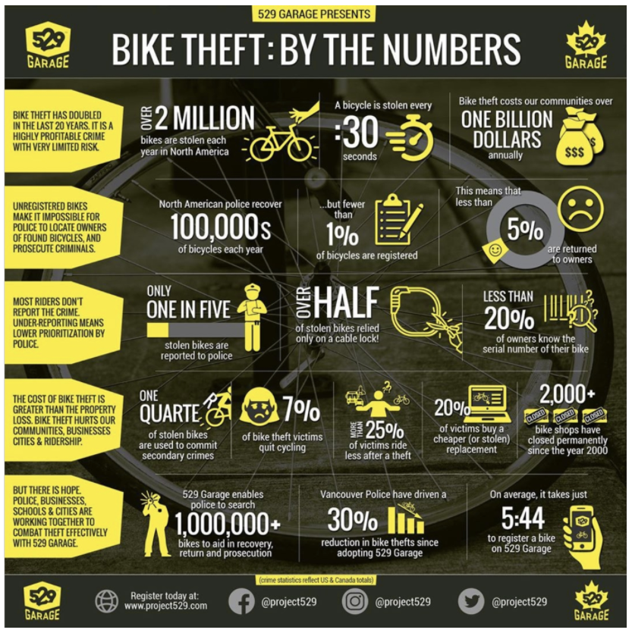
Tackling Bike Theft in Toronto
Martin sherwin

Slide 2
The Coursera IBM Data Science Professional Certification course consists of 9 online courses that covers topics including open-source tools and libraries, Python, databases, SQL, data visualization, data analysis, statistical analysis, predictive modeling, and machine learning algorithms. The course finishes with a Capstone project. The purpose of this Capstone project is to demonstrate the use of the data science toolsets, methodologies, and skills that have been acquired during this course to help solve a business problem.
background

Slide 3

In this project I am a hypothetical bike GPS location device and services vendor looking to introduce the new GPS location device that is hidden within the seat tube and a subscription-based service that monitors the location of the bike in real time. Although bike theft has always been a common issue, especially in urban areas, it has increased during the pandemic in a number of cities. The pandemic led to an unprecedented boom in bikes sales. The rising demand, increase in ridership, and shortage of bikes nationwide among other factors, has likely contributed to a rise in bike theft. With the introduction of this new product, I will be using the theft data and known bike shop locations to target my approach to market with this new product.
Problem

Slide 4
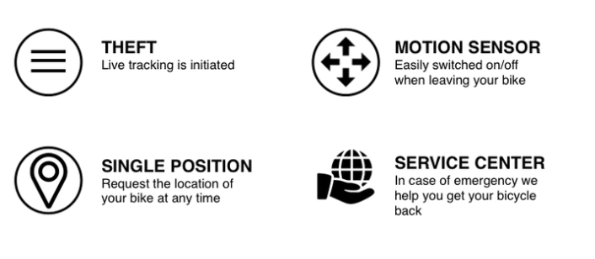
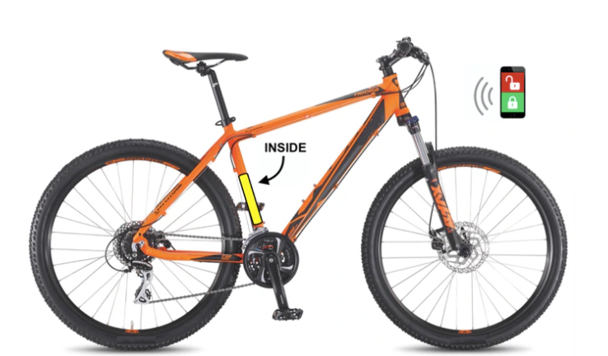
GPS Protection for your bike
solution

Slide 5
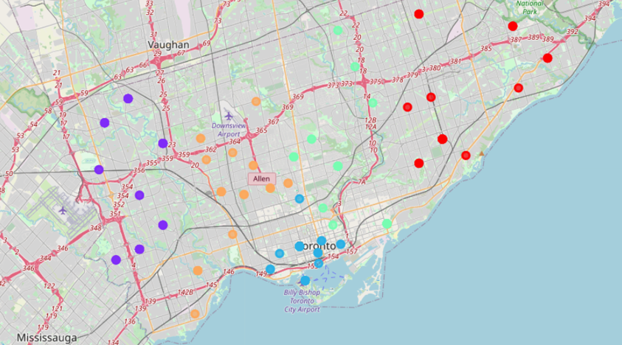
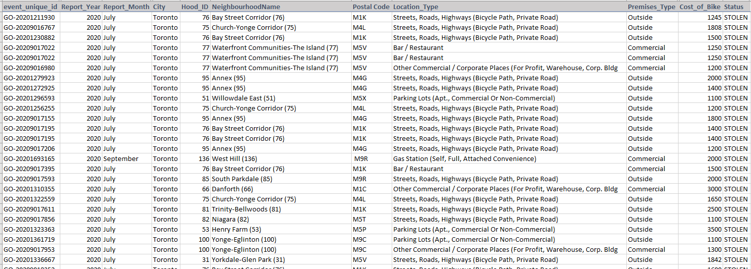
Toronto bike thefts
data

Slide 6
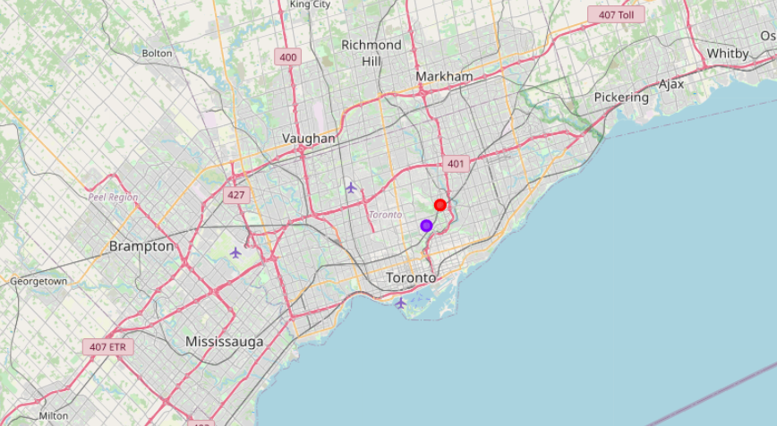
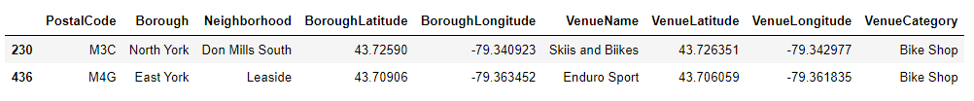
We can see that these shops sit within the Cluster 2 and Cluster 3 of the bike theft data, therefore both of these shops would be approached to start a conversation about stocking my product.
Toronto bike shops
conclusion

